Slide 1
Test case design and API Automation- ZOOMINFO
Assignment 1 – Priya Anandan

Slide 2
Assignment
Automation Testing in JavaScript:
Login API – Using POST
Details API – Using GET
Details API – Using POST and GET
Logout API – Using POST
Manual Testing Challenge:
1. Write test cases for the above API’s in an excel sheet or any open-source test management tool.
2. Write a test scenario for a coffee vending machine manufactured and tested in India but will be used in China.

Slide 3
Prototype
Login
Email
Password
Details
phone
Linkedin Url
Logout
Logout from session with valid token
calenderLink
Name
title

Slide 4
Manual Testing Challenge
Sheet 1 – TestCase_API | Covers the test case as part of manual testing challenge for API Testing
Sheet2-SampleTestdata_API | Sample test data for the written API test cases
Sheet3- TestScenario_VendingMachine | Covers the testscenario as part of manual testing challenge “Vending Machine”

Slide 5
Automation Challenge
Test Strategy
Positive
Negative
Valid Login ID and Password
Store Token ID
GET call to view user details
POST call to add/update user details
POST call to logout
Invalid Login ID and Password

Slide 6
Logic & Methodology Followed Using POSTMAN
Environment “Demo” created and BaseURL assigned
Global variable token ID set and reused in test scripts
Assertions:
Success Code check:
pm.test("Status code is 200", function () {
pm.response.to.have.status(200);});
Failure Code check :
pm.test("Status code validation: Failed POST request", function () {
pm.expect(pm.response.code).to.be.oneOf([403,400]);});
Response field validation (sample)
pm.test("Name Validation: Success",()=>{
const response =pm.response.json();
pm.expect(response.details.name).to.eql("nirdosh chauhan");});
Set Global value
const response=pm.response.json();
console.log(response.token);
pm.globals.set("tokenId", response.token);
Response field validation with multiple possible values
pm.test("ErrorMessage Validation: Your email address or password is incorrect",()=>{
const response =pm.response.json();
pm.expect(response.errorMsg).to.oneOf(["Your account has been locked due to 5 consecutive unsuccessful login attempts. Please contact your administrator to restore access.","Your email address or password is incorrect. Please try again.","Your email address or password is incorrect. You have 1 attempt remaining","Your email address or password is incorrect. You have 2 attempts remaining","Your email address or password is incorrect. You have 3 attempts remaining","Your email address or password is incorrect. You have 4 attempts remaining"]); });

Slide 7
Automation Scripts and results
Exported Automation Scripts collection file in .json →
Exported Automation Scripts Execution result file in .json →

Slide 8
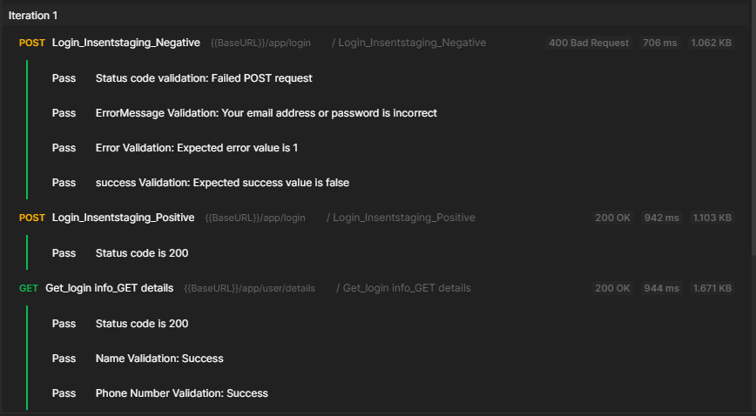
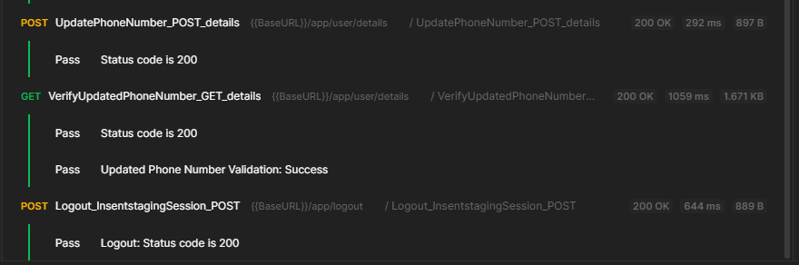
Test Run ScreenShot

